Slide 1
Evaluating the Leadership Role of Health and Wellbeing Boards as Drivers of Health Improvement and Integrated Care: Key findings
Presented by David Hunter
Professor of health Policy and Management
26th September 2017

Slide 2
Health and Wellbeing Boards: A New Dawn for Partnership Working?
Established under the Health and Social Care Act 2012 as a committee of the local authority
Forum in which key leaders from across health and care system can work together
Particular emphases on integrated services and public engagement
Great diversity in face of local contexts, cultures, histories of partnerships
Few powers: statutory duties to develop JSNAs and HWSs
System leaders or talking shops?

Slide 3
Drivers of and Barriers to Effective HWBs
Committed leaders – political and managerial
Collaborative plumbing – legacy of strong partnership working
A geography that works – coterminosity can be an asset or barrier
Response to austerity – driver for collaboration or a retreat to silos
Focus on place – local priorities that drive collaboration
Churn in the system – local government and NHS
Mission creep of national expectations – Better Care Fund; devolution; 5YFV: Vanguards, Sustainability and Transformation Plans
Getting the basics right – to enable effective systems leadership
Adapted from: Shared Intelligence 2015 and 2016

Slide 4
Evaluation Aim and Objectives
Describe the varied ways in which HWBs are configured and organised taking into account issues such as leadership, governance, membership, citizen involvement
Analyse the nature of relationships between HWB members, key stakeholders from the health system
Identify key political, institutional and organisational facilitators and barriers to effective leadership and action by HWBs for health improvement and tackling inequalities
Work with stakeholders to identify and disseminate examples of good practice for collective decision-making and integrated service provision to achieve health outcomes

Slide 5
Evaluation Design and Methods
Work package 1: Scoping the evidence base in relation to HWBs and similar partnership working arrangements
  Literature review and narrative synthesis (report 1 published May 2015)
Work package 2: Mapping the configuration and operation of HWBs across England
  National survey and elite actor interviews (report 2 published Nov 2015)
Work package 3: Exploring key stakeholder experiences and perspectives of working within or alongside HWBs
  In-depth case study research within five purposively sampled sites (completed)
Work package 4: Disseminating good practice
  HWB National Dissemination Event, 26th September 2017, Durham University

Slide 6
Case Study Sites
Site | Region | Type | Political control | Rural | Pop over 300,000 | CCGs
1 | EM | County Council | Labour | Yes | Yes | >1
2 | SW | Unitary | NOC –was Labour led now Conservative/ UKIP led | No | No | >1
3 | NE | Metropolitan District Council | Labour | No | No | 1
4 | WM | Unitary | Labour | No | Yes | >1
5 | NW | Metropolitan Borough Council | NOC – was Liberal Democrat now Labour led | No | No | 1

Slide 7
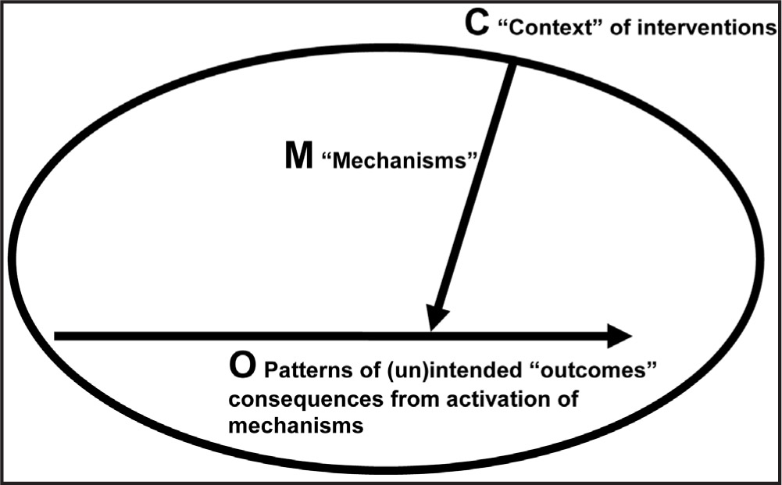
Realist Evaluation Framework
Source: (Ogrinc & Batalden 2009)

Slide 8
HWBs: Changing context
Impact of system reorganisation nationally and constant policy churn on HWBs
Impact of austerity on public finances
Tendency of national policy drivers to take precedence over HWB priorities and undermine local initiatives
Sustainability and Transformation Plans (STPs), seen as a threat which could sideline HWBs

Slide 9
HWBs: Changing context
National Priorities taking precedence
‘…[we] feel that we are being pushed into doing things that are required by central government…’.
Austerity
‘…I think the next four years looking forward is the biggest challenges I will ever have faced in my career. It’s going to be very tricky. Nobody will have any money and the demand is growing…’.
STPs
‘I don't think the health and wellbeing board had any interaction with the STP process in reality’.

Slide 10
HWBS: Purpose
National interviewees noted lack of guidance given to HWBs resulting in performance being variable and ‘patchy’
Too much focus on integration and STPs; too little attention on the wider determinants of health and tackling health inequalities.
HWBs generally had representation from the highest level of partner organisations; sub-groups provided the arena where in-depth discussions could be conducted – concerns around their accountability
Concerns over Joint Health and Wellbeing Strategies: (1) lack of ownership; (2) lack of accountability; (3) strategies partly reflected work that was on-going by other agencies; (4) too many priorities and themes; (5) no clear success measures

Slide 11
HWBs: Purpose
National Guidance
‘The legislation on HWBs is actually quite short. There’s not much that you have to do…so your JSNA, your health and wellbeing strategy and here’s some membership, and you’ve got a duty to promote integration. But it’s not highly prescriptive’.
Not enough work on wider determinants
‘I think the biggest…issue here…if you make integration the key thing…then you kind of distort the amount of airspace there is for preventative upstream public health. And getting that balance right has proved to be very difficult for a lot of boards…the evidence for that is just the amount of time that they took on the Better Care Plans. There was more intensity and more paperwork associated with that than with the whole of the introduction of the community care changes in the 1980s’.

Slide 12
HWBs: Purpose
Sub groups
‘And that’s why for me we set up the… [sub] group in the way that we’ve set it up because it’s not a minuted group…but actually that’s where you would have those discussions…where we’ve been told things that are not in the public domain that will impact on our services that they’re doing, and we can help shape and change and influence that’.
Representation
‘…the coalition…inside the health and wellbeing board actually takes it seriously. It …recognises that there is more to be gained by being in that room and working together than there is to just kind of pay it some lip service’.
Joint Health and Wellbeing Strategy
‘…we've got the wellbeing…strategy. In the year that I've been attending the board, we have not once referred to it. Nothing that's come has been linked to it’.

Slide 13
HWBs: Operation and effectiveness
Trusting and good relationships developed to varying degrees in all case study sites
Lack of engagement was a major problem due to partners having their own priorities and agendas and HWBs not being able to hold partners to account or align their priorities with those of the HWB
The third sector largely excluded, either in terms of not being invited to join the HWB or its members on boards not seen as influential
System leadership largely absent and the lack of strategic direction of HWBs was a common theme
HWBs generally not viewed as system leaders, more a collection of leaders accountable to their own organisations

Slide 14
HWBs: Operation and effectiveness
Demands and priorities in other areas of the system made system leadership difficult, with the likelihood of STPs rather than HWBs taking ownership of the system
At the same time, HWBs were the only place where the system came together
Decisions largely seen as taking place elsewhere in the system and at different levels, not within the HWB
HWBs tended to ‘rubber stamp’ decisions, and had no formal executive power
Public and user engagement remained undeveloped; HealthWatch contributed to and challenged HWBs but participants clear that their role was not to conduct public engagement work on behalf of the HWB

Slide 15
HWBs: Operation and effectiveness
Lack of system Leadership
‘The board is…not itself a system leader. It manifests system leadership and it satisfies itself that system leadership is taking place, and it places system leadership out of discussions into the public, into the formal domain. But I wouldn’t describe [it] as being itself focused, the place where system leadership happens’.
The system leader
‘We decided that we wanted to approach things in a different way. We didn’t want [the HWB] to become a council committee. We didn’t want to be a council committee where we sat there with papers just coming through. We think we are doing something that is different. Actually, this committee has got significant clout and is setting direction. The added value is that it is bringing more unified decisions’.

Slide 16
HWBs: Operation and effectiveness
Lack of decision making
‘…it’s done some good things, but what decisions has health and wellbeing board taken that wouldn’t have been taken if it didn’t exist? In preparation for this conversation, I was racking my brain because I’ve been a member of it from its inception, I couldn’t think of one’.
Lack of public engagement
‘I think perhaps we're not as good as we should be at that [public engagement] because I think we are systems leadership at that level rather than that lower level. I think we all have an understanding of who we're representing, but perhaps that may be a failing that we haven’t grasped that as well as we should do’.

Slide 17
Integration
Significant developments in two case study sites: in one, integration overseen by the HWB; in the other it was largely, for historical reasons, separate from the board
In other sites work on integration was variable: in one study site concerns over CCGs having different integration plans which did not necessarily align, and opposed to pooled budgets
Overall, historical context, good relationships/partnerships and trust were seen as key drivers in securing effective integration
Barriers to integration
‘’One of the things we talked about was integration with health …So we set up several evenings of meetings which was of the CCGs and providers and we were doing quite well until we actually got round to actually talking about money then everybody rushed into the corners and it didn't get much further then. So I think we felt somewhat frustrated’.

Slide 18
HWBs: Impact on outcomes
General lack of outcomes and progress in achieving the Joint Health and Wellbeing Strategy (JHWS) produced by HWBs: reasons included insufficient accountability, lack of strategic focus, insufficient monitoring
Study sites did not offer much evidence of outcomes that were driven specifically by HWBs or how they linked to the overall JHWS or were driven by the Joint Strategic Needs Assessment (JSNA), (with the exception of two sites in some instances)
Emerging evidence in one site: HWB had set up sub-groups aligned to the aims of the JHWS; it was believed that with the board acting in a coordinating role it had helped bring programmes to fruition earlier as a consequence

Slide 19
HWBs: Impact on outcomes
‘…do I know any decision or any outcome that the health and wellbeing board have been focused on in the last 12 months and the answer was no. I could not think of anything... I couldn't think of a single thing that they made a difference on, which is pretty sad really’.
‘I don't think we're at the stage of seeing outcomes; I think we can see progress. I think there's definitely movement in the right direction’.

Slide 20
Future of HWBs
In terms of challenges likely to face HWBs in the future,
4 themes were dominant across the study sites:
Continuing financial challenges coupled with growing demand on services
STP process could sideline HWBs which needed to be more actively engaged
Continuous system re-structuring and reorganisation causing instability and uncertainty
In regard to opportunities across the case study sites, STPs were a primary focus of discussion and it was a common (though not universal) belief that HWBs needed to work at a population health level (larger than the local authority footprint) with STPs

Slide 21
Future of HWBs
Austerity
‘There will be real challenges around money, the resources to make sure we’re doing the right things, and that’s because health are going to have cuts as well…’.
HWBs and STPs
‘I think this is becoming more and more apparent, that with the STP the place of the health and wellbeing board is questionable, and what power and teeth the health and wellbeing board and what leadership it can actually have in the city is questionable’.

Slide 22
Future of HWBs
Continuous system churn
‘…at the moment we’re in the middle of a reorganisation with our CCGs…that all puts things up in the air again…So that then gives us another year where you’ve got board members that are really on the way out. And no board works effectively if members of that board don’t know where they’re going to be in six to nine months’.
HWBs and STP opportunities
‘You know I think they [HWBs] will work because the STPs will need them to deliver locally and they are the place where people come together…nobody ever talks about the being got rid of in the way they talk about other parts of the system…nobody’s talked about getting rid of health and wellbeing boards, at least not that I’m aware of’.

Slide 23
Future of HWBs
A majority of participants in our baseline interviews believed that
HWBs would be missed if they were abolished. Two main reasons
were given:
HWBs brought partners together and prompted a range of perspectives; they were the only place the system came together
If HWBs did not exist they would have to be invented
For those who believed HWBs would not be missed, two main
reasons were cited:
HWBs did not drive decisions
HWBs had no impact, did not add value and did not own the health and social care agenda – STPs driving the agenda

Slide 24
Future of HWBs
Would HWB be missed - No
‘[We]…could function perfectly well without it…Because we don't need it for the integration thing, I don't think we've actually ever bottomed out what we do need it for…’.
Would HWB be missed - Yes
‘I think it would be missed and people would say, well, we need a forum to pull together partners on this agenda, so I'm confident that it plays a role and it's adding value. The key question is, are we doing enough, having got that in place, to drive the system forward? I think that's where the challenge is, really’.

Slide 25
Future of HWBs
Interviewees were asked what they would change nationally
if they were in charge of the development of HWBs – 4
themes emerged:
Give HWBs greater role definition
Ensure HWB members were accountable for delivery of priorities of the board
HWBs needed to have a commissioning function
HWBs needed more powers to fulfil their role, such as to ensure they could hold partners accountable for outcomes prioritised by the board

Slide 26
Future of HWBs
HWBs and a defined role
‘I think as long as within the next six months we are absolutely clear that we are in that prevention space and we can develop things in that area, I think it will help us going forward. The problem has been we’ve been far too scattergun, so people don’t know whether we stand for something or fall for anything’.
HWBs and holding partners to account
‘The problem…is [HWBs] they’re not accountable. And if you’ve got no kind of controls, and you can’t hold people to account, apart from through having a good relationship and a conversation, actually it means they’re not terribly effective. So if I was health minister…would I want them to continue? I think I’d want to give them more powers…’.

Slide 27
Future of HWBs
HWBs and commissioning
‘I suppose the powerful is the money. So you’d have to say they are the commissioners. You will commission your activities at the health and wellbeing board, they will be buying the services…It’ll all go through them’.
A view that HWBs need more power
‘I think it’s the power to follow through really. I think if you basically say, this is our joint health and wellbeing strategy and in this we’ve got to do such and such, and the CCG isn’t doing it, the health and wellbeing board should be able to go to the CCG and say look this needs to happen’.

Slide 28

For further information go to
https://www.dur.ac.uk/public.health/projects/current/prphwbs/

Slide 29
Roundtable discussions
There will be two breakout sessions: 12:05-12:30 and 12:35-13:00
Delegates have a choice between three topics:
Public engagement and involvement (PCL058)
Integration of health and social care (PCL053)
Wider determinants of health, wellbeing and inequalities (PCL057)
Each group will have a facilitator and a note-taker
By the end of the second session, groups are expected to come up with two questions per topic for the panel discussion taking place after lunch

Slide 30
Regional / Public Health England perspective on the future of Health & Wellbeing Boards in the North East
Peter Kelly
Centre Director – PHE North East

Slide 31
A reminder of the role of PHE
(and local government and the NHS)
  To protect the health of the public
  To improve the health and wellbeing of the public
  To reduce inequalities in health and wellbeing

Slide 32
Reminder of the role of the HWB Board
Health and Wellbeing Boards are a formal committee of the local authority charged with promoting greater integration and partnership between bodies from the NHS, public health and local government.
They have a statutory duty, with Clinical Commissioning Groups (CCGs), to produce a joint strategic needs assessment and a joint health and wellbeing strategy for their local population.
Above all, the HWB Board is concerned about the population it serves……PLACE

Slide 33
Give every child the best start in life
Marmot – much quoted

Slide 34
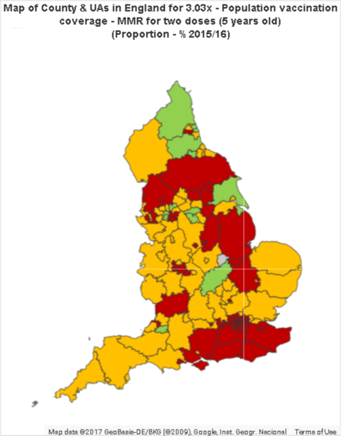
Population vaccination coverage - MMR for two doses (5 years olds)

Slide 35
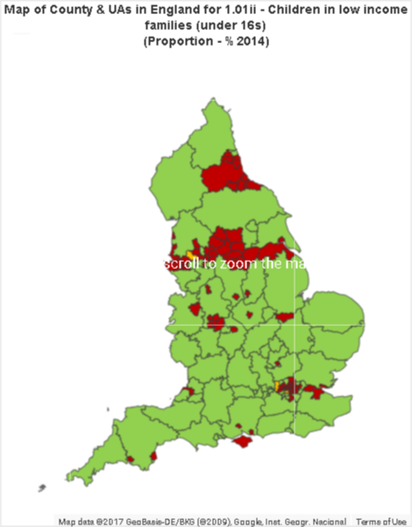
Children in low income families (under 16s)

Slide 36
A crowded place – governance post 2013
  Health and Wellbeing Boards
  Clinical Commissioning Groups (CCGs)
  NHS England

Slide 37
New NHS landscape
Sec of State
Input
DH
Public Health England
National Health Watch
Input
NHS England
Monitoring
Clinical Senates
Clinical Networks
Commissioning services and monitoring contracts from …
Local Authority
(Director of Public Health)
Clinical Commissioning Groups (CCGs)
Scrutiny Committee
Local Health Watch
Evolved from LINks
Commissioning services from …
Health & Wellbeing Boards
(ensuring strategic and coordinated commissioning)
Specialised services
GPs,
Dentists, Opticians, Pharmacists
NHS
Trusts
(most to become
FTs)
Monitor
Independent Sector
CQC
Regulation

Slide 38
A crowded place – governance emerging in 2017
  Health and Wellbeing Boards
  Clinical Commissioning Groups (CCGs)
  NHS England
  Sustainability and Transformation Partnerships (STPs)
  Accountable Care Organisations (ACOs)
  Accountable Care Systems (ASCs)
  Devolution – not everywhere and not aligned with the above in the North East

Slide 39
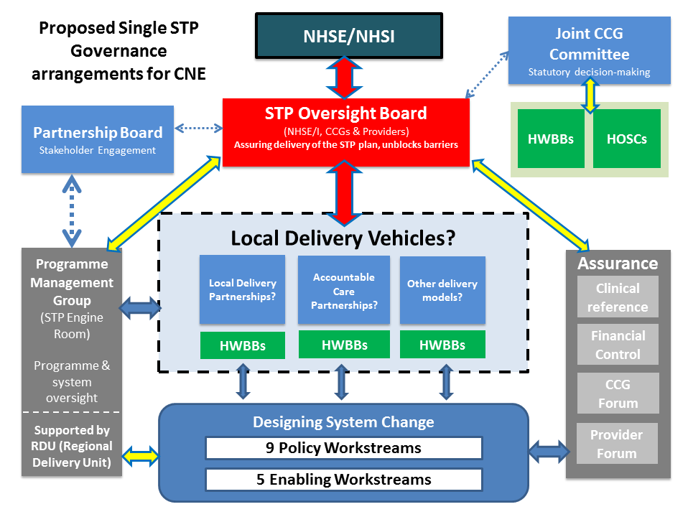
Draft proposed single STP governance arrangements

Slide 40
Reminder of the role of the HWB Board
Health and wellbeing boards are a formal committee of the local authority charged with promoting greater integration and partnership between bodies from the NHS, public health and local government.
They have a statutory duty, with Clinical Commissioning Groups (CCGs), to produce a joint strategic needs assessment and a joint health and wellbeing strategy for their local population.
Above all, the HWB Board is concerned about the population it serves……PLACE

Slide 41
Holding an ACO contract: health and wellbeing requirements
The Contract will stipulate some requirements of the ACO which will include:
    the requirement to conduct a population health needs assessment;
    to develop strategies to improve the health and wellbeing of the population;
    the requirement to seek to address underlying health inequalities.

Slide 42
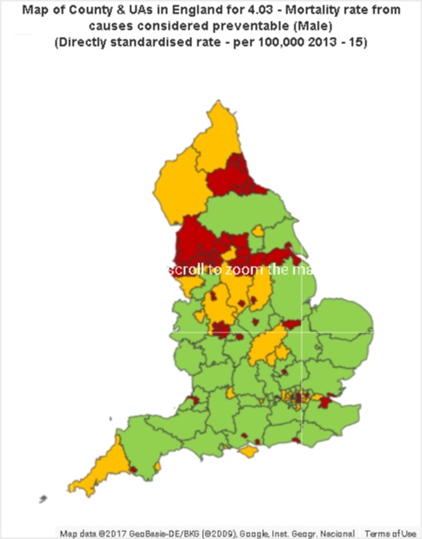
Mortality rate from causes considered preventable (Male)

Slide 43
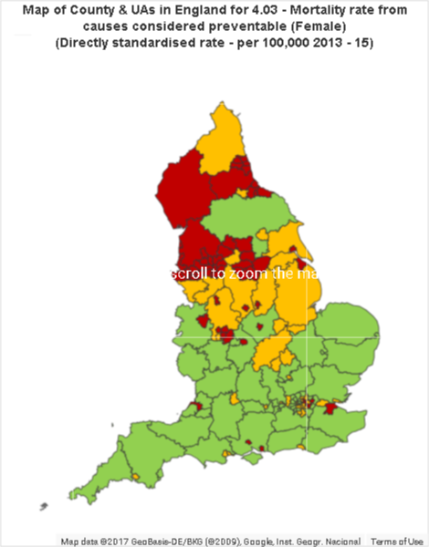
Mortality rate from causes considered preventable (Female)

Slide 44


Slide 45
Is there a chasm developing?
  Local Government (understandably) is place based
  STPs and ACOs (understandably) are NHS centric and service based
  What is the relevance of HWB Boards for STPs and ACOs?

Slide 46
The challenge of governance
  Is it actually possible to reconcile the complex governance between multiple political organisations and complex NHS governance?
  Do HWB Boards (ie local authorities) want to be consultees or decision makers?
  Is there a critical mass of HWB Boards? Should there be?

Slide 47
Mayors and place-based initiatives
  The newly-elected Mayors are driving initiatives across multiple organisations and agencies:
  The Mayor of Bristol has established a Bristol City Office which brings together the city’s resources to focus on cross-cutting challenges such as early intervention.
  The Mayor of Greater Manchester pledged to end rough sleeping by 2020 in his election manifesto, and launched the Homelessness Fund on his first day in office, adding 15 per cent of his own salary into the pot.
  The Cambridgeshire and Peterborough devolution deal includes a commitment to a co-design of their Work and Health Programme.
  The West Midlands has a mental health commission and a commitment to reduce inequality in healthy life expectancy
Source: Metro --- Dynamics PHE draft report in publication

Slide 48
North East Assets
  Strong North East identity
  Right critical mass
  High performing public sector services – past and present
  Strong relationships
  Huge potential for growth – must be inclusive

Slide 49
The leadership challenge
  Leaders within organisations will need to look beyond the interests of their own organisations to drive improvement in wellbeing outcomes across their PLACE, leading a cultural change to a health and care system in which each health and care £ is used most effectively to support wellbeing, independent of the source of the funding.

Slide 50
HWB Boards are at a crossroads
  HWB Boards are a collection of individual leaders. Can they work internally together to provide collective leadership in a complex governance structure in the North East?
  Can they maximise the potential of their assets by working closer with each other to solve a very large shared and difficult problem? ie to improve the health and wellbeing of the North East of England and reduce health inequalities

Slide 51
Health and Wellbeing Boards: my journey & looking forward
Professor Chris Bentley
Chris.bentley19@gmail.com

Slide 52
Structures for Commissioning of Public Health (Bentley 2011)
SoSH
Chief Medical
Officer
DH Policy
NHS Commissioning Board
National
Public Health
Service
NHS System
DPH
GP
Commissioning
Health and
Wellbeing
Board
Integrated
Provision
LA
Commissioning
LA System
SoSH - Secretary of State for Health
DPH
- Director of Public Health

Slide 53
HWBs will be the
Beating Heart
of Health and Wellbeing Locally

Slide 54

EXTEND
LOCAL
DEMOCRACY

Slide 55
Reformed English Health and Healthcare structures 2016 (Bentley 2016)
SoSH
Chief Medical
Officer
DH Policy
NHS England
Public Health
England
Sub-national
structures
NHS System
Integrated
Provision
CCGs
Health and
Wellbeing
Board
DPH
LA
Commissioning
LA System
SoSH - Secretary of State for Health
DPH
- Director of Public Health

Slide 56
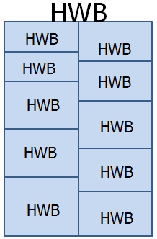
‘No further guidance on HWB structure – local discretion’
LA/HWB
LA/HWB
CCG
CCG
CCG
LA/HWB
CCG
CCG
LA/HWB

Slide 57
‘Added value of HWBs’ (Wandsworth LSP)
The perception locally is that the creation of the HWB brings with it very limited extra ‘powers’.
Key extra value to the system locally includes the following:
  It brings important components of local leadership together, to enable them to develop a common view..
  With leadership holding common views, ‘if they want things to happen, they can happen’.
  It provides a good vehicle for sharing intelligence
  It provides a mechanism for local resolution of potential splits in governance (NHS England Area Team; populus; PHE Centre).

Slide 58
10 Steps to Population Level Outcomes
Governance: who is running the show?
e.g. strategic forum or performance driver
Programme planning: who is accountable?
responsible and empowered
Information Governance: sharing intelligence
data flows; communication strategy

Slide 59
Pink and Fluffy HWB Talking Shop
Lean and Competent HWB
System Leaders – the Business

Slide 60
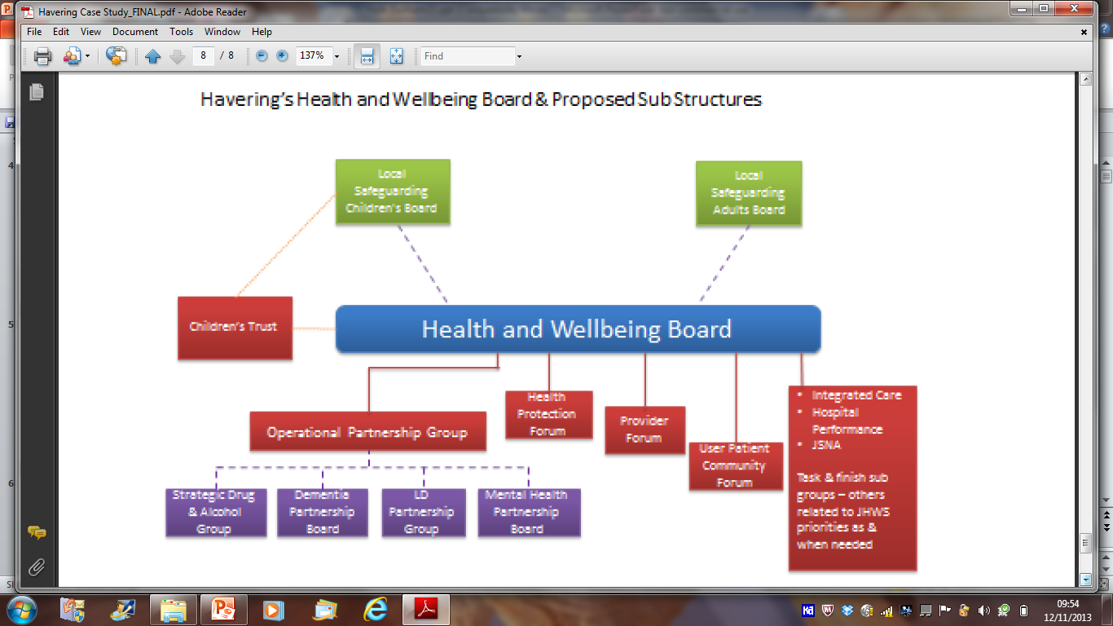

Slide 61
Engaging key membership
CCGs
  OK having realised that “HWBs ‘R Us”
Healthwatch
  Took a while to get sorted. Not the link to community
Voluntary, Community and Faith Sector
  Engaged, but often not systematically
Connecting to communities
  Channels to most equity interest groups

Slide 62
10 Steps to Population Level Outcomes
Joint Strategic Needs Assessment
bottom-up and top-down
Priority setting: how does it really work?
evidence; ethics; politics

Slide 63
The Threat of Winter
DEATH
Disability
Hypothermia
Accidents
Illness
Misery
Loneliness
Anxiety
DEPRESSION

Slide 64
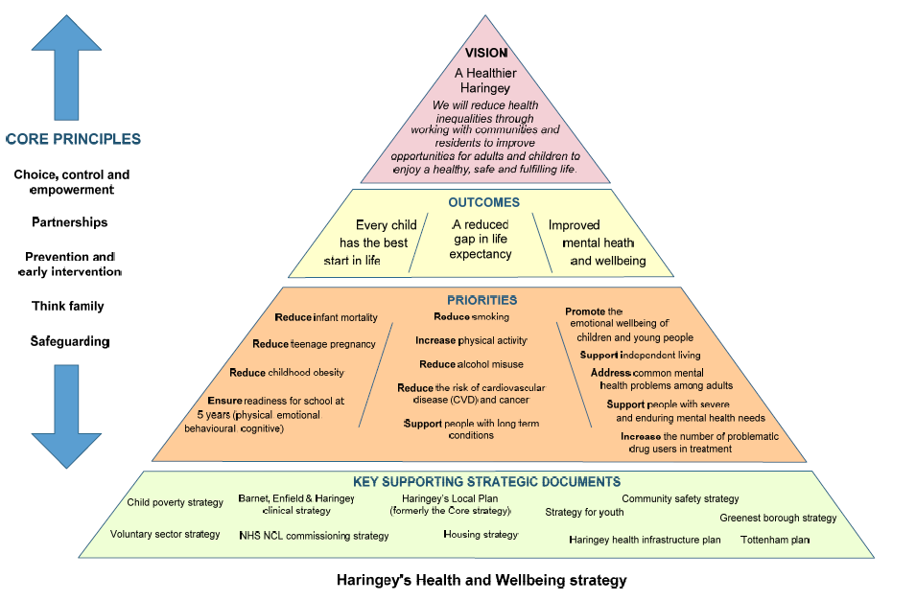

Slide 65
10 Steps to Population Level Outcomes
Setting targets: locally relevant and meaningful
measureable; ambitious; do-able
Select interventions: strongly evidence based
offer major contribution to change required
Develop business plan: economic case for change
cost benefit; cost utility; Return on Investment; Cost Consequence Analysis (CCA)

Slide 66
Pink and Fluffy HWS
PC Policy Bingo
Lean and Competent HWS
Realistic targets; considered means; accountability

Slide 67
Return on Investment
Poor educationalattainment
A & E and
Healthcare
Social
Care
Reduction of Alcohol Related Harm Prevents
Crime and
Disorder
Unemployment

Slide 68
10 Steps to Population Level Outcomes
Whole system approach
population level; through communities; services

Slide 69
Civic Level
Interventions
Systematic and scaled interventions through
services
Systematic community engagement
Health and Wellbeing Board
Partnership,
Vision and Strategy,
Leadership and Engagement
Intervention Through
Services
Intervention Through Communities
Service engagement
with the community
Producing Percentage Change at Population Level
C. Bentley
2007

Slide 70
10 Steps to Population Level Outcomes
Maximise impact: minimise inequalities
service quality; population support; co-ordination

Slide 71
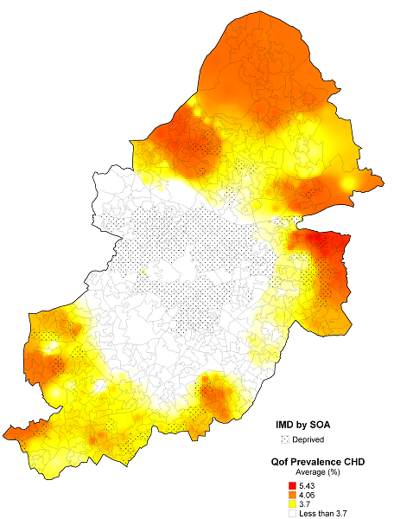
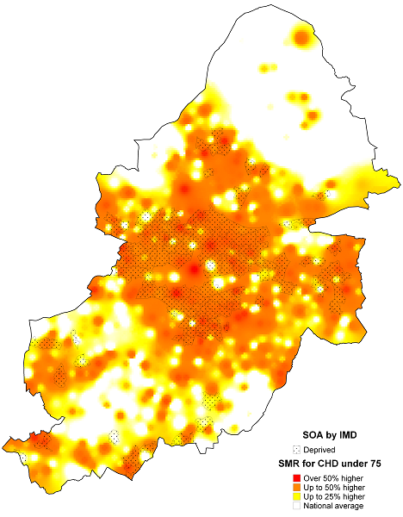
  Identify and connect effectively with the ‘missing thousands’.

Slide 72
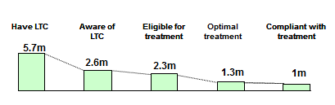
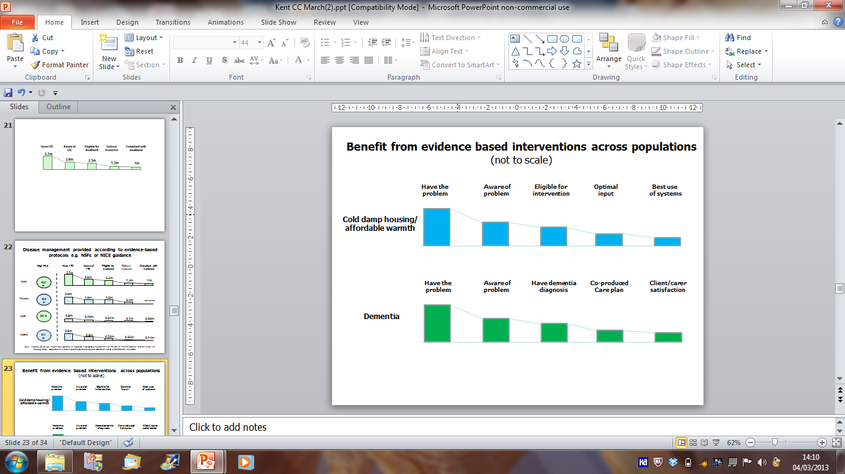
Coronary Heart Disease
Cold Damp Housing

Slide 73
Components of ‘Implementation Decay’
Have the
problem
Aware of
problem
Eligible for
intervention
Optimal
intervention
Compliance
with plan
A
B
C
D
Under-recognition of risks or condition by individuals and people around them
Risk or condition identified but support/advice or intervention not accessible
Inadequacies in quality of in-service provision
Insufficient assets for recovery or ongoing support for self-management
Bentley, C 2016

Slide 74
Collaboration to address ‘implementation decay’
Lead service
HWB partners
Have the
problem
Aware of
problem
Eligible for
intervention
Optimal
intervention
Compliance
with plan
A
B
C
D
Chris Bentley 2012

Slide 75
Sheffield Intervention Decay (A+B+C+D) Strategy
A | B | D
Resilient communities Active citizenship and health literacy Healthy Community Programme (stress; healthy eating; debt) Altogether better Health Champions Social capital and connectivity with ‘seldom seen’ residents Single point of access advice and support channels | Sheffield Wellbeing consortium Health Champions + Practice Health Champions Advocates Front-line services: No-wrong door Reduced handoffs Shared key workers Data-sharing Outreach and community venues Single point of access advice and support channels | Practice health champions Social prescribing Co-ordinated voluntary services support Healthy Community Programme Health Champions

Slide 76
Civic Level
Interventions
Systematic and scaled interventions through
services
Systematic community engagement
Units of Place-based planning
Health and Wellbeing Board
Partnership,
Vision and Strategy,
Leadership and Engagement
Intervention Through
Services
Intervention Through Communities
Service engagement
with the community
Producing Percentage Change at Population Level
C. Bentley
2007

Slide 77
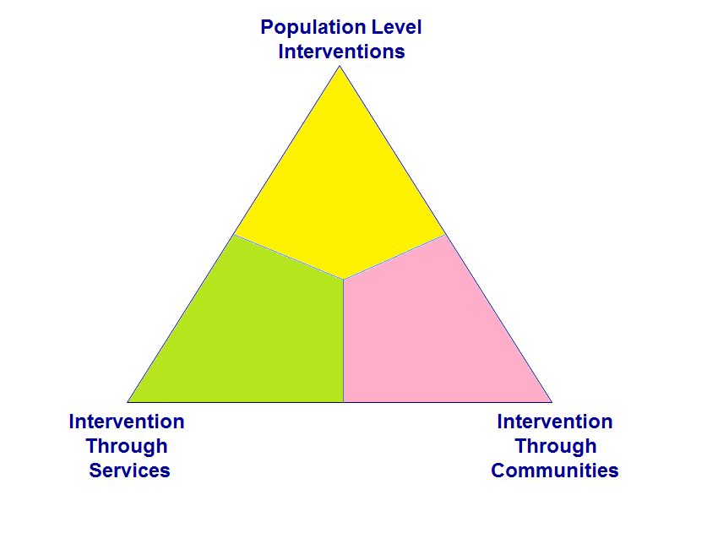
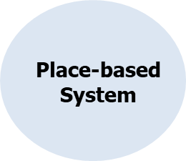
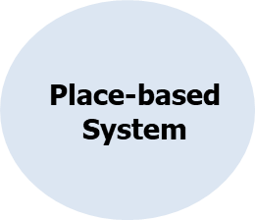
Civic level interventions
STP, ACS, ACO
Community
based
interventions
Service
based interventions
Gminas
The Population Intervention Triangle (Bentley 2017)
Producing Percentage Change at Population Level
C. Bentley
2007

Slide 78
5 Year Forward View
Prevention and Public Health

Slide 79
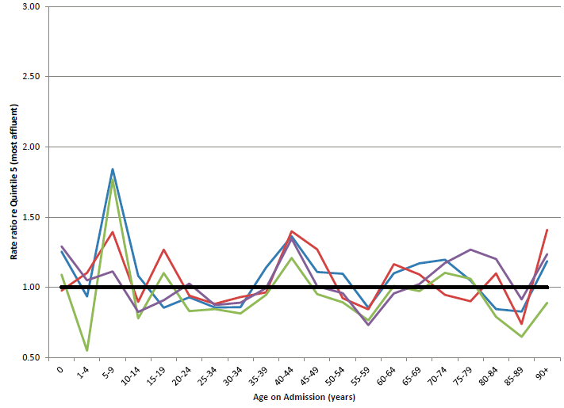
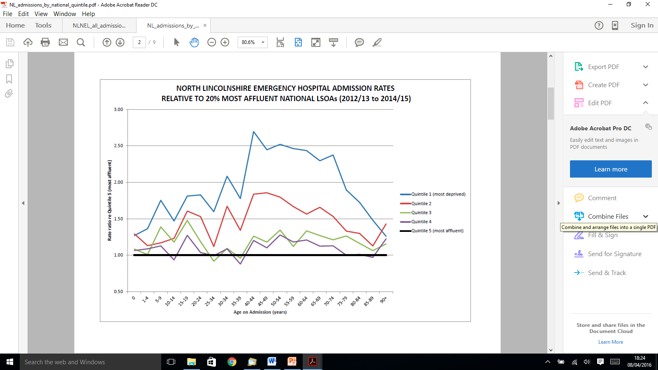
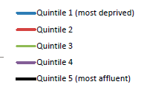
HOSPITAL ADMISSION RATES
RELATIVE TO 20% MOST AFFLUENT NATIONAL LSOAs
Elective admissions
Emergency admissions

Slide 80
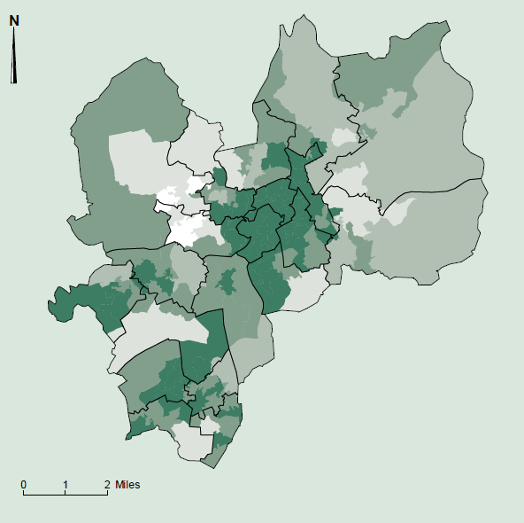
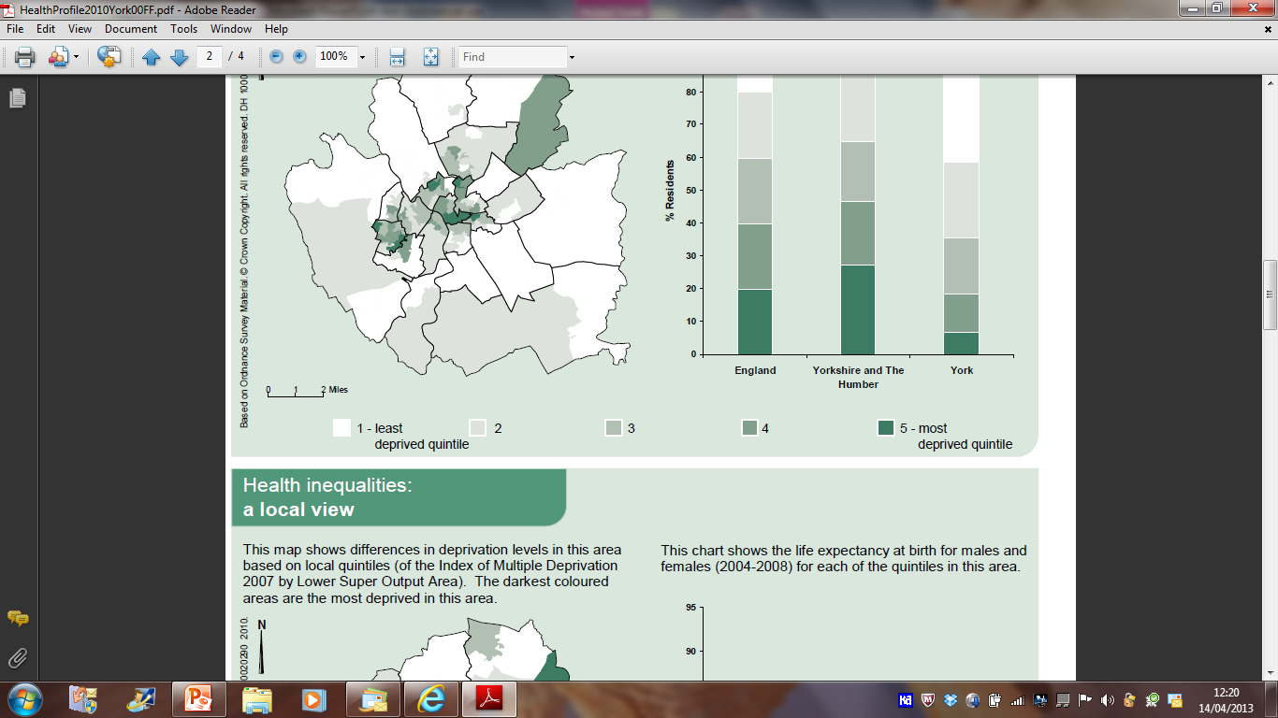
Heywood, Middleton and Rochdale
Index of Multiple Deprivation (IMD)
% of residents from each English quintile

Slide 81
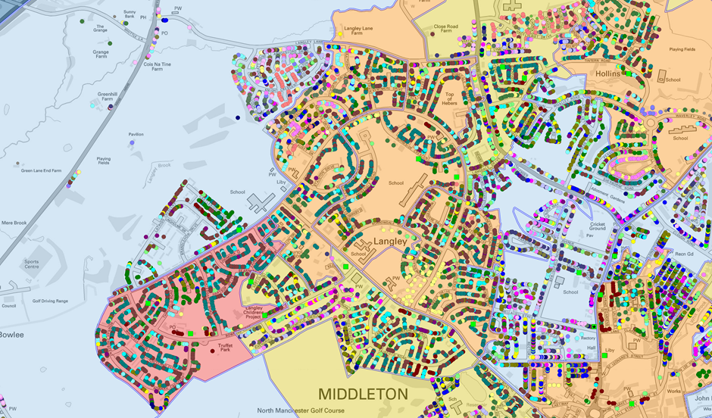
Langley – E01005552, E01005527, E01005551, E01005529

Slide 82
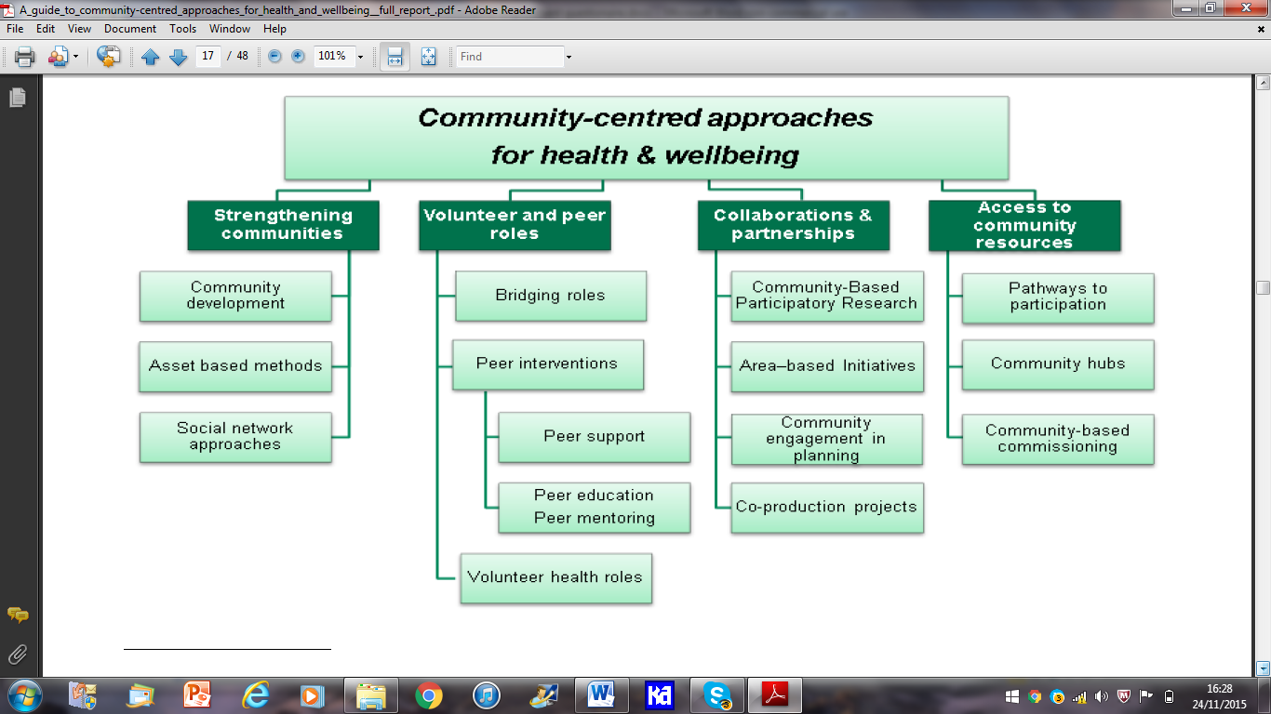
South, J 2015 PHE

Slide 83
STPs and ACSs
Political imperative
National press profile
Discipline from above
  The regulators NHS E; NHS I
The money
  single system ‘control total’
  But
Reversion to type
Political change

Slide 84
HWBs
Statutory in law
  Unlike STPs; ACS; ACOs
Build together social determinants
  Real early start; skills for life; employment; housing; community safety; air quality
Connect into community infrastructure and assets
  Build up to hubs as Care Closer to Home integrates down
Will ‘Place-based’ work without local democracy?
  Elected members; Overview and Scrutiny; VCF sector
Beating Heart
Don’t still the

